Slide 1

TRAFFIC ACCIDENT PREDICTION
COMPUTER SCIENCE ENGINEERING
SUBMITTED TO:- DR. KAMLESH DUTTA
SUBMITTED BY:- RAJNI SUTHAR
ROLL NUMBER:- 20DCS018

Slide 2
OUTLINES
Introduction
Objectives
Dataset 1
Dataset 2
Dataset 3
Dataset 4
Models
Evaluation Metrics
Summary

Slide 3
Introduction
Traffic accidents are a significant public safety concern that results in the loss of lives, injuries, property damage, and substantial economic costs. The ability to predict and mitigate the occurrence of traffic accidents has gained immense importance in recent years, driven by advancements in data analytics, machine learning, and a growing awareness of the need for improved road safety. Traffic accident prediction refers to the application of data-driven models and analytics techniques to anticipate where and when accidents are likely to happen, with the goal of reducing their frequency and severity.

Slide 4
Objectives
The objectives of traffic accident prediction are to improve road safety, reduce the frequency and severity of traffic accidents, and minimize the associated economic and social costs. Here are the specific objectives of traffic accident prediction.
Datasets for Traffic Accident Prediction
Data Set1 : US Accidents (2016 - 2023) (https://www.kaggle.com/datasets/sobhanmoosavi/us-accidents/data)
Data Set 2:Road Accident (United Kingdom (UK)) Dataset(https://www.kaggle.com/datasets/devansodariya/road-accident-united-kingdom-uk-dataset)
Data Set 3:Hazardous-Driving-Spots-Around-the-World(https://www.openml.org/search?type=data&status=active&id=43372&sort=runs)
Data Set 4: Road Accidents in India (Road Accidents in India (kaggle.com))

Slide 5
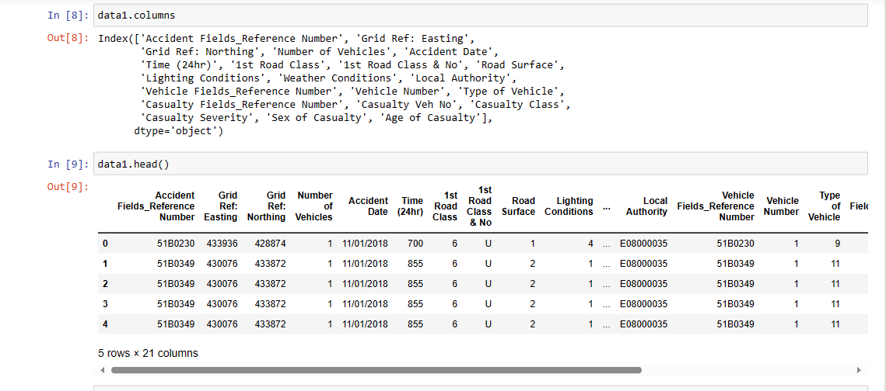
1st Dataset
Data Set Loading
Check Weather Data Set is imbalanced :
Imbalanced Columns: ['Accident Date', '1st Road Class & No', 'Local Authority']

Slide 6
Mean , Median or Mode for Dataset 1:
Column: Grid Ref: Easting
Mean: 429987.0320802005
Median: 429895.0
Mode: 431457
Column: Grid Ref: Northing
Mean: 434137.7739348371
Median: 433969.0
Mode: 430270
Column: Number of Vehicles
Mean: 1.919298245614035
Median: 2.0
Mode: 2
Column: Time (24hr)
Mean: 1409.3684210526317
Median: 1503.0
Mode: 1500
Column: 1st Road Class
Mean: 4.449624060150376
Median: 6.0
Mode: 6
Column: Road Surface
Mean: 1.2691729323308272
Median: 1.0
Mode: 1
Column: Lighting Conditions
Mean: 1.9393483709273183
Median: 1.0
Mode: 1
Column: Weather Conditions
Mean: 1.2275689223057644
Median: 1.0
Mode: 1
Column: Vehicle Number
Mean: 1.5042606516290726
Median: 1.0
Mode: 1
Column: Type of Vehicle
Mean: 8.167919799498748
Median: 9.0
Mode: 9
Column: Casualty Veh No
Mean: 1.5042606516290726
Median: 1.0
Mode: 1
Column: Casualty Class
Mean: 1.5543859649122806
Median: 1.0
Mode: 1
Column: Casualty Severity
Mean: 2.818045112781955
Median: 3.0
Mode: 3
Column: Sex of Casualty
Mean: 1.4105263157894736
Median: 1.0
Mode: 1
Column: Age of Casualty
Mean: 36.99398496240602
Median: 35.0
Mode: 23

Slide 7
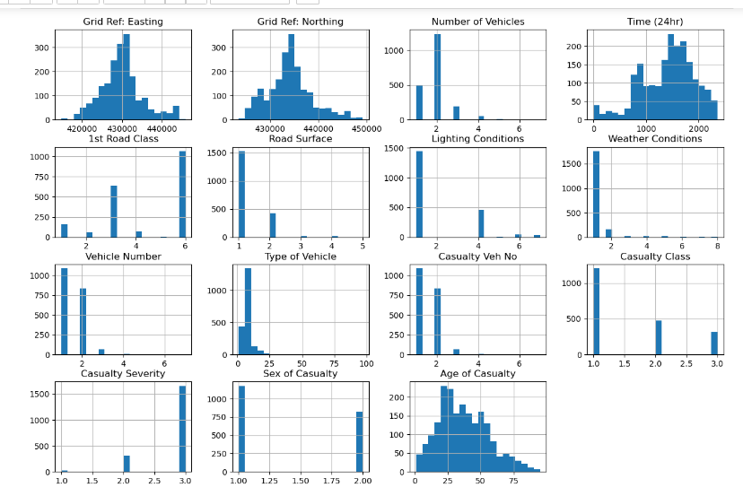
Frequency and Data Distributions using Histogram For Data Set 1

Slide 8
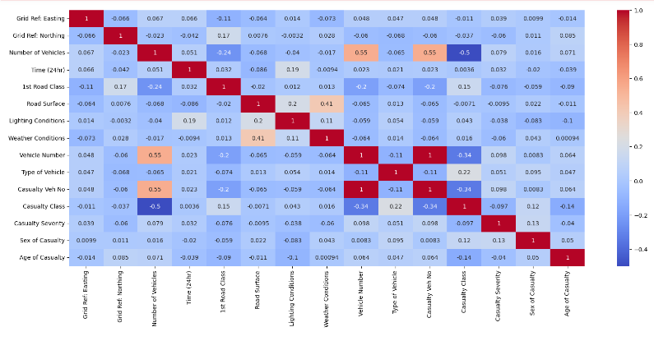
Correlation heat map for numeric columns

Slide 9
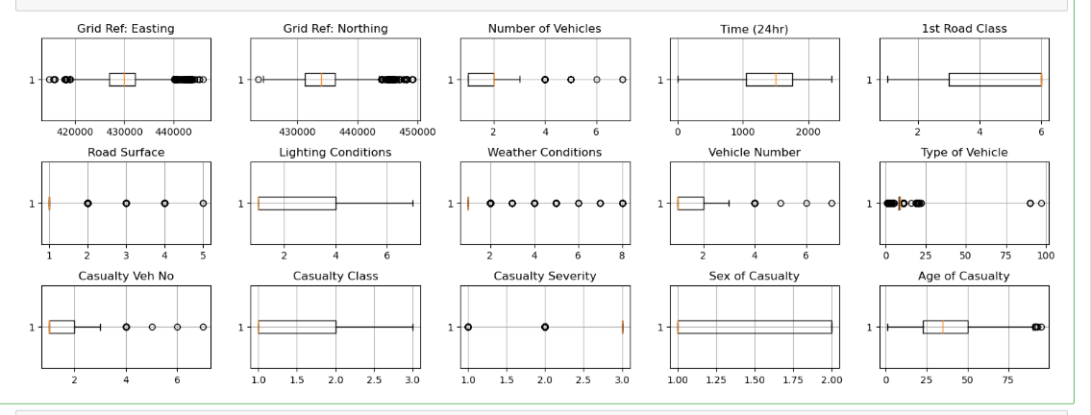
Outliers in Data Set 1

Slide 10
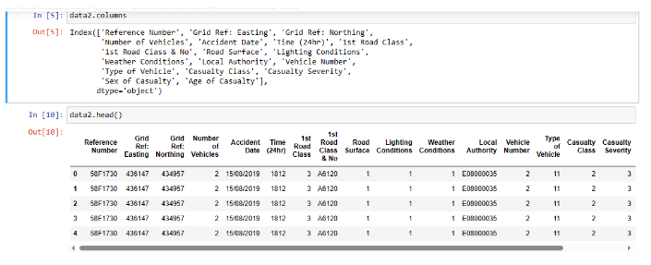
2nd Dataset
Check Weather Data Set is imbalanced :
Imbalanced Columns: ['Accident Date', '1st Road Class & No', 'Local Authority']

Slide 11
Mean , Median or Mode for Dataset 2:
Column: Grid Ref: Easting
Mean: 430273.6046145779
Median: 430096.0
Mode: 430846
Column: Grid Ref: Northing
Mean: 434036.86156266386
Median: 433982.0
Mode: 434032
Column: Number of Vehicles
Mean: 1.9690613529103305
Median: 2.0
Mode: 2
Column: Time (24hr)
Mean: 1385.4950183534347
Median: 1500.0
Mode: 1630
Column: 1st Road Class
Mean: 4.399580492920818
Median: 6.0
Mode: 6
Column: Road Surface
Mean: 1.3219716832721553
Median: 1.0
Mode: 1
Column: Lighting Conditions
Mean: 1.911903513371788
Median: 1.0
Mode: 1
Column: Weather Conditions
Mean: 1.241740954378605
Median: 1.0
Mode: 1
Column: Vehicle Number
Mean: 1.5579444153120083
Median: 2.0
Mode: 1
Column: Type of Vehicle
Mean: 8.344520188778185
Median: 9.0
Mode: 9
Column: Casualty Class
Mean: 1.5673833245936024
Median: 1.0
Mode: 1
Column: Casualty Severity
Mean: 2.8017829050865233
Median: 3.0
Mode: 3
Column: Sex of Casualty
Mean: 1.3974829575249081
Median: 1.0
Mode: 1
Column: Age of Casualty
Mean: 35.79811221814368
Median: 32.0
Mode: 27

Slide 12
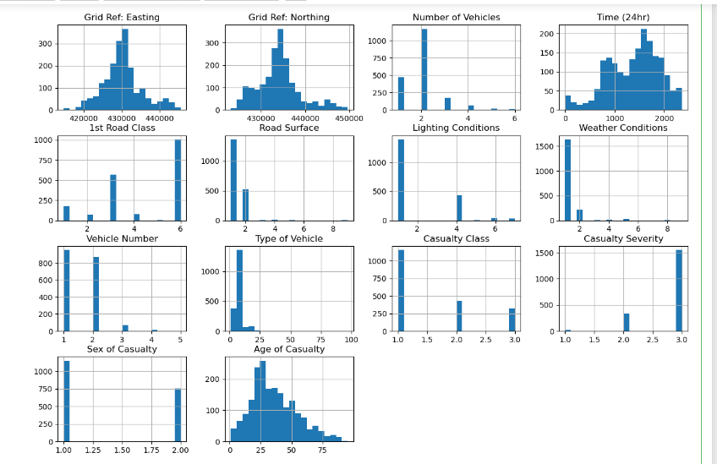
Frequency and Data Distributions using Histogram For Data Set 2

Slide 13
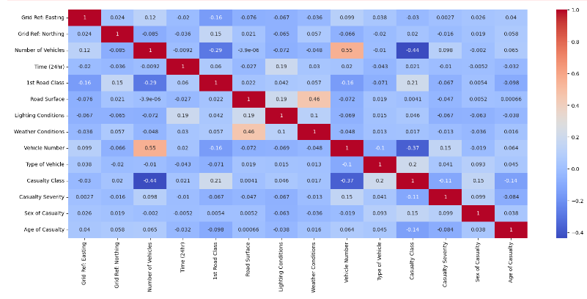
Correlation heat map for numeric columns

Slide 14
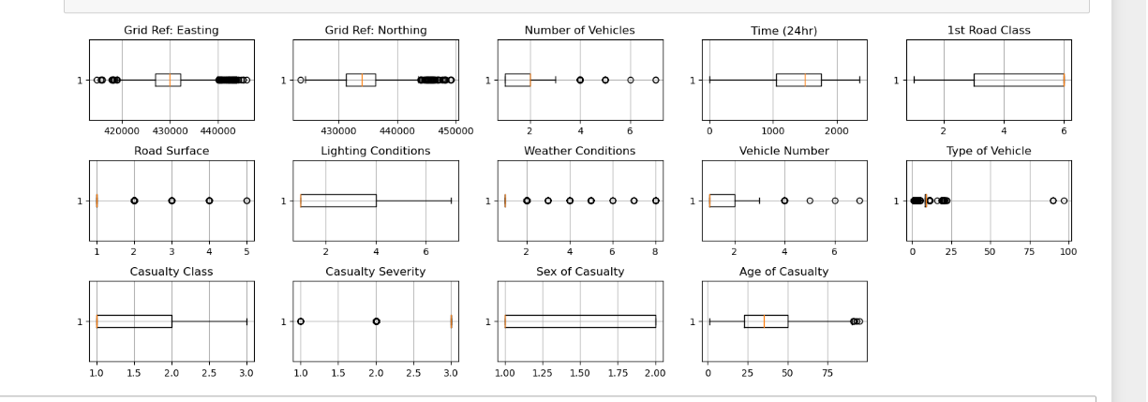
Outliers for Data Set 2

Slide 15
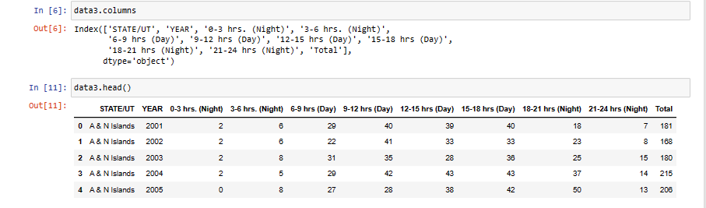
3rd Dataset
Check Weather Data Set is imbalanced : Imbalanced Columns:[]

Slide 16
Mean , Median or Mode for Dataset 3
Column: YEAR
Mean: 2007.5
Median: 2007.5
Mode: 2001
Column: 0-3 hrs. (Night)
Mean: 796.3204081632653
Median: 200.0
Mode: 0
Column: 3-6 hrs. (Night)
Mean: 969.2367346938776
Median: 251.5
Mode: 0
Column: 6-9 hrs (Day)
Mean: 1371.1510204081633
Median: 498.5
Mode: 0 Column: 9-12 hrs (Day)
Mean: 1753.9673469387756
Median: 678.0
Mode: 0
Column: 12-15 hrs (Day)
Mean: 1681.8142857142857
Median: 679.5
Mode: 0
Column: 15-18 hrs (Day)
Mean: 1850.2836734693878
Median: 669.0
Mode: 0
Column: 18-21 hrs (Night)
Mean: 1782.9183673469388
Median: 517.0
Mode: 0
Column: 21-24 hrs (Night)
Mean: 1228.8102040816327
Median: 343.5
Mode: 0
Column: Total
Mean: 11434.502040816327
Median: 4174.5
Mode: 0

Slide 17
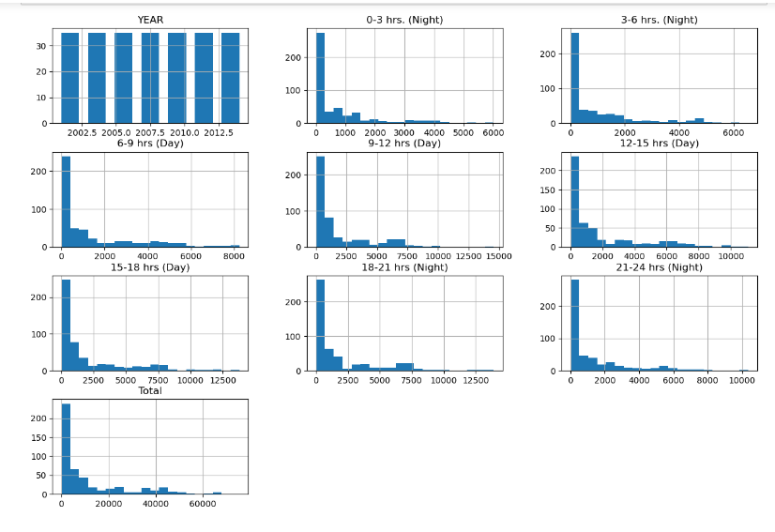
Frequency and Data Distributions using Histogram For Data Set 3

Slide 18
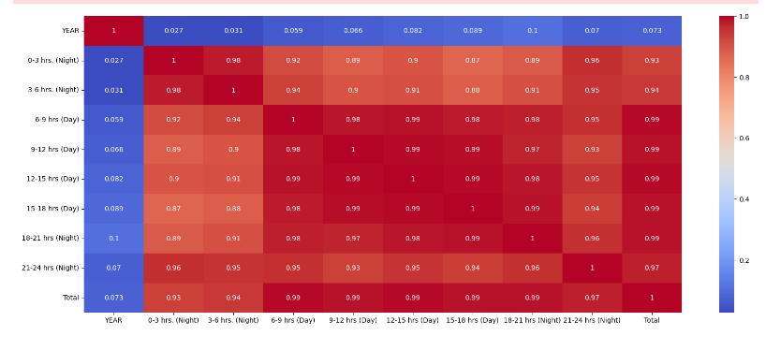
Correlation heat map for numeric columns

Slide 19
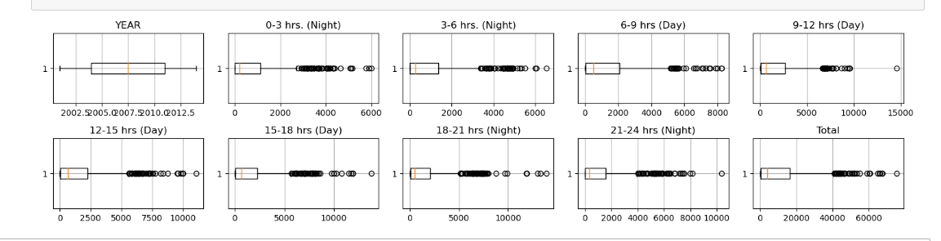
Outlier for Data Set 3

Slide 20
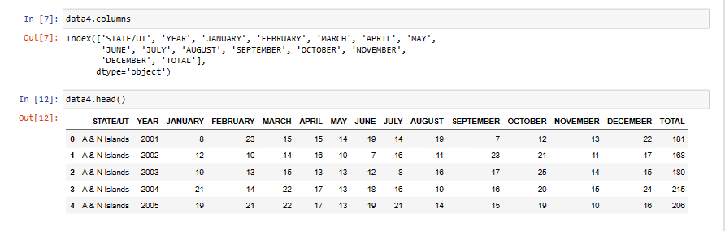
4th Dataset
Check Weather Data Set is imbalanced :
Imbalanced Columns: ['STATE/UT']

Slide 21
Mean , Median or Mode for Dataset 4
Column: YEAR
Mean: 2007.5
Median: 2007.5
Mode: 2001
Column: JANUARY
Mean: 985.1408163265306
Median: 329.5
Mode: 6
Column: FEBRUARY
Mean: 937.2897959183673
Median: 348.5
Mode: 0
Column: MARCH
Mean: 992.1244897959184
Median: 369.0
Mode: 0
Column: APRIL
Mean: 978.9040816326531
Median: 350.0
Mode: 0
Column: MAY
Mean: 1064.4142857142858
Median: 387.5
Mode: 0
Column: JUNE
Mean: 966.4775510204082
Median: 342.5
Mode: 0
Column: JULY
Mean: 898.4959183673469
Median: 308.0
Mode: 0
Column: AUGUST
Mean: 894.5938775510205
Median: 313.0
Mode: 0
Column: SEPTEMBER
Mean: 888.3714285714286
Median: 311.5
Mode: 0
Column: OCTOBER
Mean: 928.4918367346938
Median: 311.5
Mode: 0
Column: NOVEMBER
Mean: 933.0448979591837
Median: 331.0
Mode: 0
Column: DECEMBER
Mean: 967.1530612244898
Median: 347.5
Mode: 0
Column: TOTAL
Mean: 11434.502040816327
Median: 4174.5
Mode: 0

Slide 22
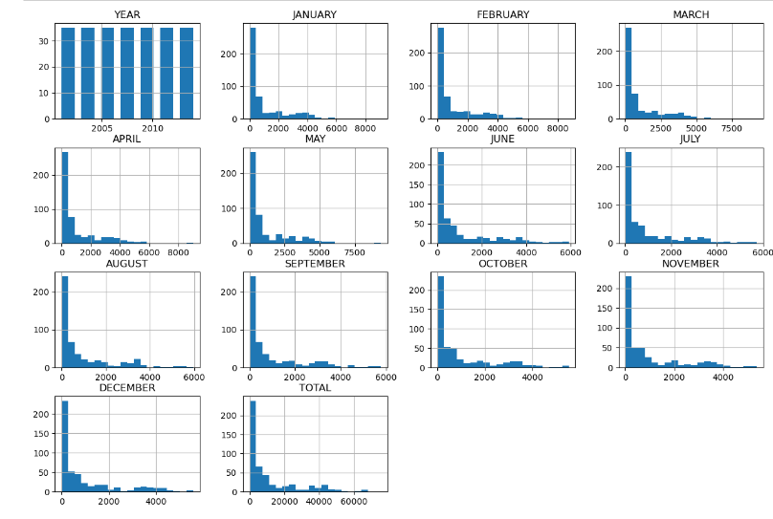
Frequency and Data Distributions using Histogram For Data Set 4

Slide 23
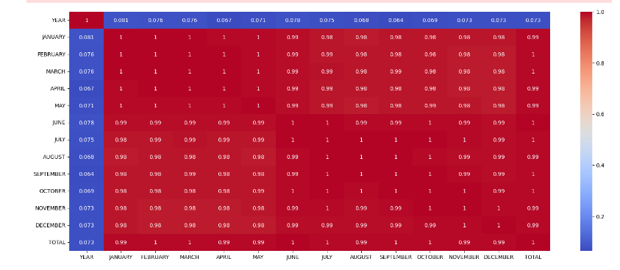
Correlation heat map for numeric columns

Slide 24
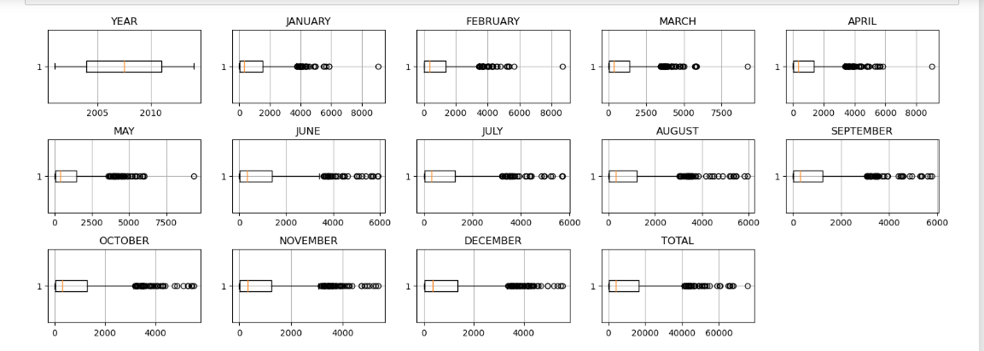
Outliers for Data Set 4

Slide 25
Model Training
The dataset is trained on four models linear Regression, Random Forest , SVM model and Decision Tree Classifier.
Linear Regression: It is used for predicting a continuous outcome variable (dependent variable) based on one or more predictor variables (independent variables). It models the relationship between the variables as a linear equation, aiming to find the best-fitting line (or hyper plane) that minimizes the sum of squared differences between the observed and predicted values. It is used for problems where the relationship between variables is roughly linear.
2. Decision Tree: It is a supervised learning algorithm used for both classification and regression tasks. It creates a tree-like model of decisions and their consequences. At each internal node of the tree, a decision is made based on one of the input features, leading to a branch corresponding to the possible outcomes. This process continues until a final decision (leaf node) is reached. Decision Trees are easy to understand and interpret but can be prone to over fitting if not properly pruned.

Slide 26
Model Training
Support Vector Machine (SVM): SVM is a supervised machine learning algorithm used for both classification and regression tasks. It works by finding the optimal hyper plane that best separates different classes in a high-dimensional feature space. The primary objective is to maximize the margin between classes, making SVM effective in cases where the data is not linearly separable.
4. Random Forest: Random Forest is an ensemble learning method that combines multiple decision trees to improve predictive accuracy. It works by creating a collection of decision trees and aggregating their predictions. Each tree is constructed from a random subset of the data, and the final prediction is obtained by averaging (for regression) or voting (for classification) the predictions from individual trees.

Slide 27
Linear Regression Model
For Data Set 1
Coefficients: [ 0.04428294 -0.00875663 0.02398015 -0.00555943 -0.04804786]
Intercept: 2.806133469000831
Mean Squared Error: 0.15595556756117437
R-squared: -0.007968590098511141
For Data Set 2
Coefficients: [ 0.04269876 -0.01315217 -0.04068989 -0.01648262 0.01003534]
Intercept: 2.847079774734122
Mean Squared Error: 0.18666500926387025
R-squared: -0.003607266195829295

Slide 28
Linear Regression Model
For Data Set 3
Coefficients: [0.11111111 0.11111111 0.11111111 0.11111111 0.11111111 0.11111111 0.11111111 0.11111111 0.88888889]
Intercept: 1.2732925824820995e-11
Mean Squared Error: 5.221461714685703e-22
R-squared: 1.0
For Data Set 4
Coefficients: [1. 1. 1. 1. 1. 1. 1. 1. 1. 1. 1. 1.] Intercept: 5.4569682106375694e-12 Mean Squared Error: 1.0079207449373342e-22 R-squared: 1.0

Slide 29
Decision Tree Model
For Data Set 1:
Accuracy: 0.8320802005012531
Classification Report: precision recall f1-score support
1 0.00 0.00 0.00 4
2 0.30 0.05 0.09 56
3 0.85 0.97 0.91 339
accuracy 0.83 399
macro avg 0.38 0.34 0.33 399
weighted avg 0.77 0.83 0.78 399
For Data Set 2:
Accuracy: 0.8167539267015707
Classification Report: precision recall f1-score support
1 0.00 0.00 0.00 6
2 0.25 0.03 0.06 61
3 0.83 0.98 0.90 315
accuracy 0.82 382
macro avg 0.36 0.34 0.32 382
weighted avg 0.72 0.82 0.75 382

Slide 30
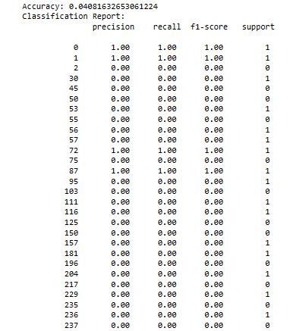
Decision Tree Model
For Data Set 3

Slide 31
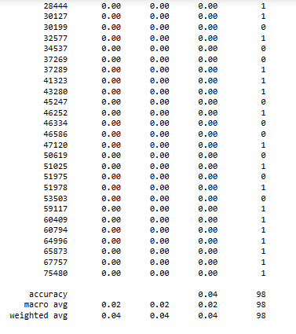

Slide 32
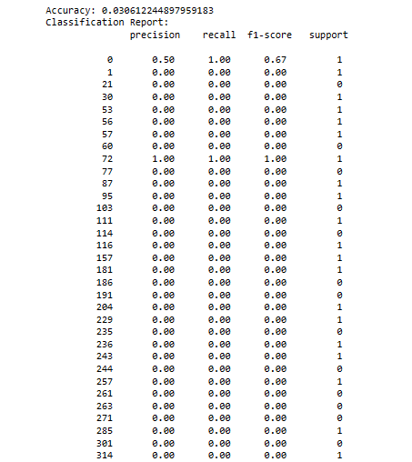
Decision Tree Model
For Data Set 4

Slide 33
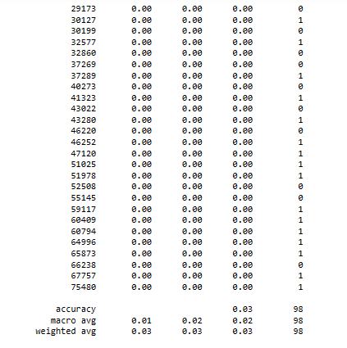

Slide 34
SVM Model
For Data Set 1
Accuracy: 0.849624060150376
Classification Report: precision recall f1-score support
1 0.00 0.00 0.00 4
2 0.00 0.00 0.00 56
3 0.85 1.00 0.92 339
accuracy 0.85 399
macro avg 0.28 0.33 0.31 399
weighted avg 0.72 0.85 0.78 399
For Data Set 2
Accuracy: 0.824607329842932
Classification Report: precision recall f1-score support
1 0.00 0.00 0.00 6
2 0.00 0.00 0.00 61
3 0.82 1.00 0.90 315
accuracy 0.82 382
macro avg 0.27 0.33 0.30 382
weighted avg 0.68 0.82 0.75 382

Slide 35
SVM Model
For Data Set 3
Accuracy: 0.0
Classification Report: precision recall f1-score support
0 0.00 0.00 0.00 0.0
1 0.00 0.00 0.00 1.0
accuracy 0.00 1.0
macro avg 0.00 0.00 0.00 1.0
weighted avg 0.00 0.00 0.00 1.0

Slide 36
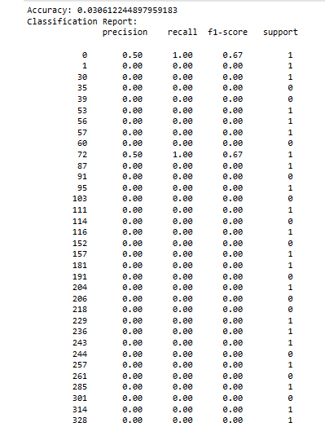
For Data Set 4

Slide 37
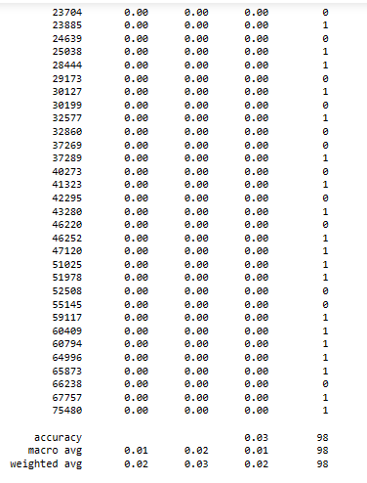

Slide 38
Random Forest Model
For Data Set 1
Accuracy: 0.8395989974937343
Classification Report: precision recall f1-score support
1 0.00 0.00 0.00 4
2 0.43 0.05 0.10 56
3 0.85 0.98 0.91 339
accuracy 0.84 399
macro avg 0.43 0.34 0.34 399
weighted avg 0.79 0.84 0.79 399
For Data Set 2
Accuracy: 0.8167539267015707
Classification Report: precision recall f1-score support
1 0.00 0.00 0.00 6
2 0.17 0.02 0.03 61
3 0.83 0.99 0.90 315
accuracy 0.82 382
macro avg 0.33 0.33 0.31 382
weighted avg 0.71 0.82 0.75 382

Slide 39
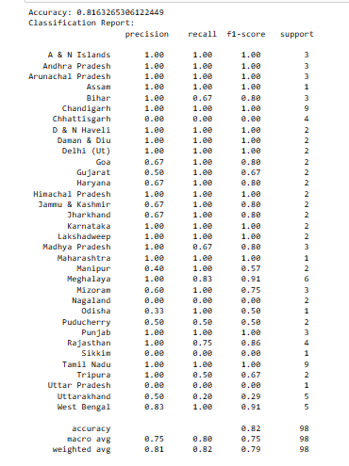
Random Forest Model
For Data Set 3

Slide 40
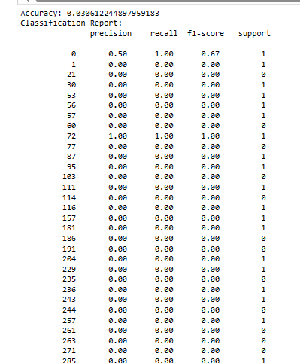
Random Forest Model
For Data Set 4

Slide 41
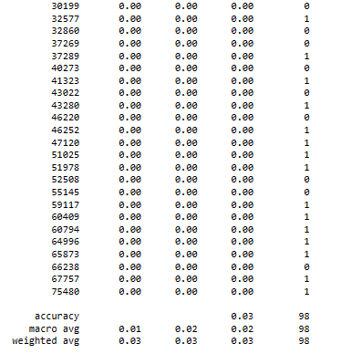
For Data Set 4

Slide 42
EVALUATION METRICS
Accuracy: Accuracy is a common metric to consider, especially when you are dealing with a balanced dataset and want to measure the overall correctness of your predictions. However, accuracy may not be the best metric if the dataset is imbalanced, as it can be misleading.
Precision and Recall: are crucial for evaluating the performance of a model, particularly when dealing with imbalanced datasets. Precision measures the ability of the model to correctly identify positive cases (accidents), while recall measures the model's ability to find all positive cases. Depending on the application, you may want to prioritize precision (minimizing false alarms) or recall (minimizing missed accidents).
Mean Absolute Error (MAE) or Mean Squared Error (MSE): If your prediction task involves predicting the severity, frequency, or impact of accidents (e.g., the number of casualties or property damage), regression metrics like MAE or MSE can be used to measure the accuracy of your predictions.
Log Loss (Logarithmic Loss): If your model outputs probabilities, you can use log loss to measure the accuracy of these probabilities. This metric is particularly relevant for probabilistic models.

Slide 43
Root Mean Squared Error (RMSE): If you are using regression models and need to measure the error in predicting accident severity or other continuous values, RMSE can be a suitable metric.
Summary
Maximum Accuracy : 83.20%
Maximum Precision: 76.81%
Recall: 83.21%
Maximum Mean Absolute Error (MAE): 29.97%
Maximum Mean Squared Error (MSE): 19.69%
Maximum Log Loss: 91.55%
Maximum Mean Squared Error (RMSE): 44.38%

Slide 44
Thank You

